Slide 1

Fundamental Of Structured Programming Lecture 4
Dr. Ahmed Yousry
Lecturer, Computer Science Department,
Faculty of computers and artificial intelligence, benha university

Slide 2


Slide 3
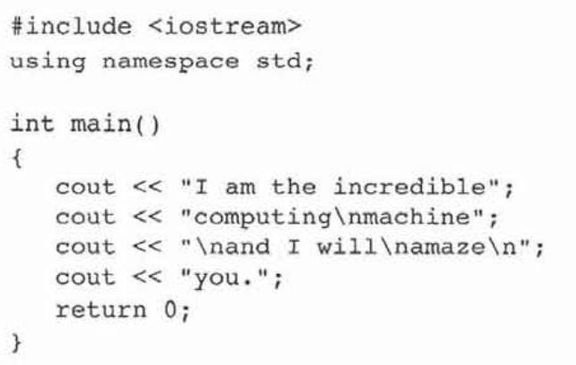
Revision
What will the following program print on the screen
I am incredible computing
machine
and I will
amaze
You

Slide 4
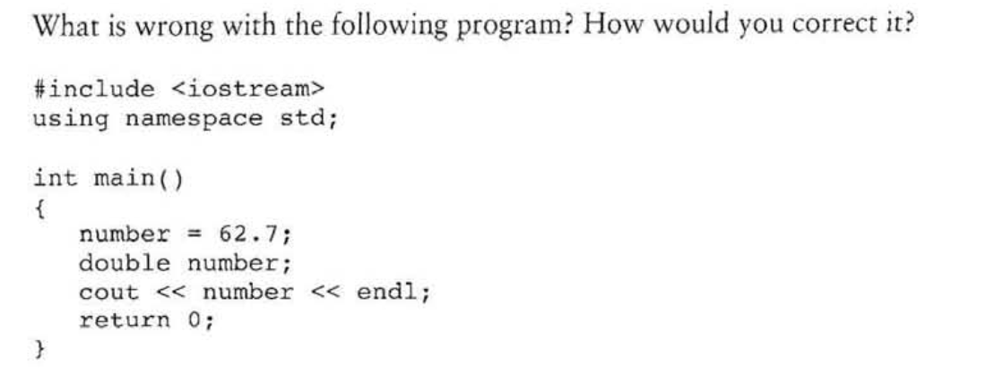
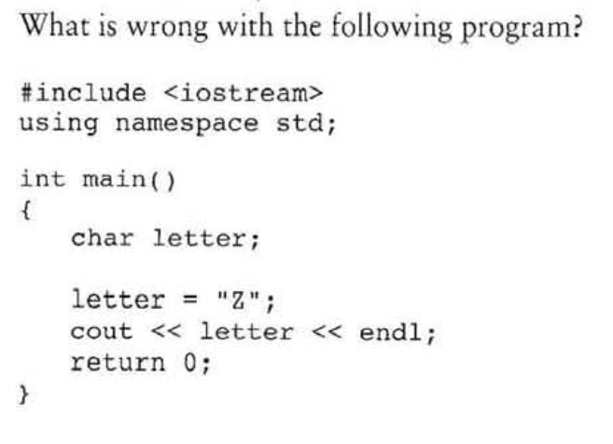
double number ;
number =62.7;
Letter =‘z’

Slide 5
Select the correct answer
The negation operator is ___ _
unary
binary
ternary
none of the above
which of the following are not valid assignment statements? (Select all that apply.)
total = 9 ;
72 = amount;
profit = 129
letter = 'W';
which of the following are not valid cout statements? (Select all chat apply.)
cout « "Hello World":
cout « "Have a nice day"\n;
cout < value;
cout << Programming is great fun ;

Slide 6
Chapter 3: Expressions and Interactivity

Slide 7
The cin Object
Standard input object
Like cout, requires iostream file
Used to read input from keyboard
Information retrieved from cin with >>
>> called Stream extraction operator
Input is stored in one or more variables
cin >> length >> width;
Often used with cout to display a user prompt first
cout << "What is the length of the rectangle? " ;
cin >> length;

Slide 8
The cin Object
Can be used to input multiple values
cin >> height >> width;
Multiple values from keyboard must be separated by spaces or [Enter]
Must press [Enter] after typing last value
Multiple values need not all be of the same type
Order is important; first value entered is stored in first variable, etc.
User input goes from keyboard to the input buffer, where it is stored as characters
cin automatically converts the information read from the keyboard to the data type of the variable used to store it.
int height;
cout << "How tall is the room? ";
cin >> height;
Notes:
See pr3-03.cpp and pr3-04.cpp

Slide 9
<< and >>
Notice the >> and << operators appear to point in the direction information is flowing.
The >> operator indicates information flows from cin to a variable.
cin>> hour
The << operator shows that information flows from a variable (or constant) to cout.
cout <<hour

Slide 10
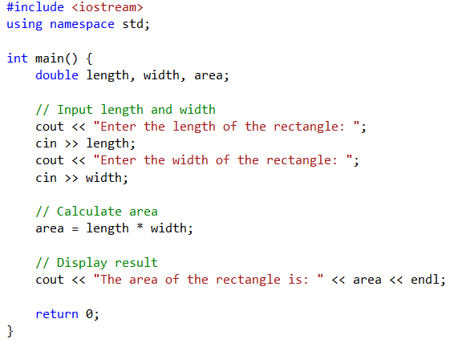
Example of using cin
Program Output:
Enter the length of the rectangle: 10
Enter the width of the rectangle: 5
The area of the rectangle is: 50

Slide 11
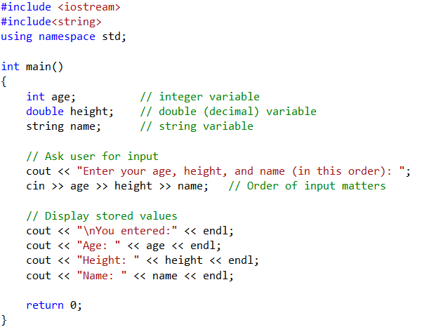
Example: Entering Multiple Values
Program Output:
Enter your age, height, and name (in this order): 20 5.8 Alice
You entered:
Age: 20
Height: 5.8
Name: Alice

Slide 12
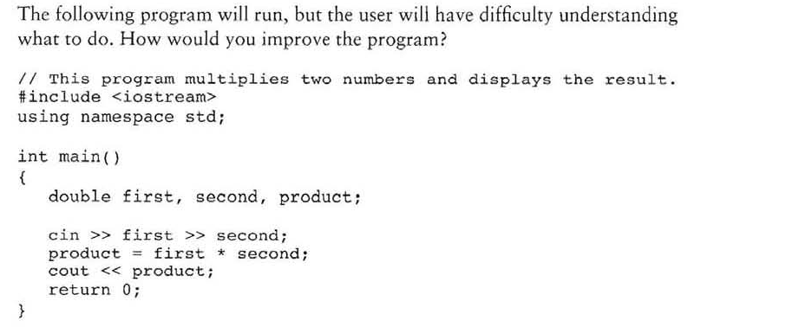
Example

Slide 13
Mathematical Expressions
Can create complex expressions using multiple mathematical operators
An expression can be a literal, a variable, or a mathematical combination of constants and variables
Example
12
Weight
a+b/c
Can be used in assignment, cout, other statements:
perimeter = 2 * PI * radius;
cout << "border is: " << 2*(l+w);
Mathematical expressions are evaluated from left to right.
Usually, an expression consists of an operator and its operands.
This is an expression
These are expressions

Slide 14
Order of Operations
In an expression with more than one operator, evaluate in this order:
Do first :( ) expressions in parentheses
Do next:- (unary negation), in order, left to right
Do next :* / %, in order, left to right
Do last: + -, in order, left to right
In the expression 2 + 2 * 2 – 2
evaluate
third
evaluate
second
evaluate
first

Slide 15
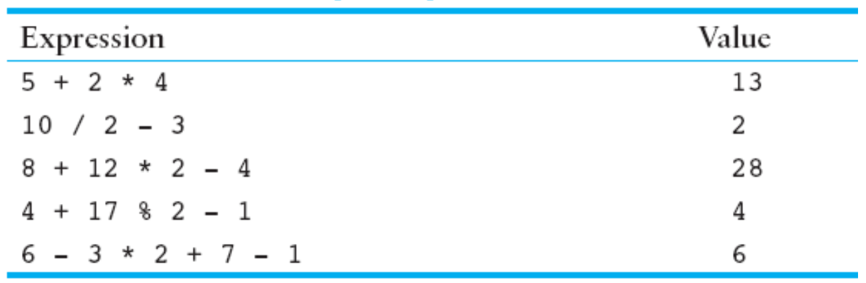
Order of Operations

Slide 16
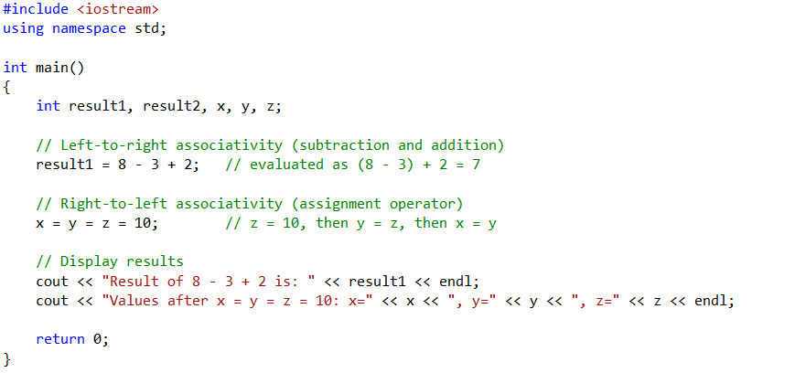
Associativity of Operators
Program Output:
Result of 8 - 3 + 2 is: 7
Values after x = y = z = 10: x=10, y=10, z=10

Slide 17
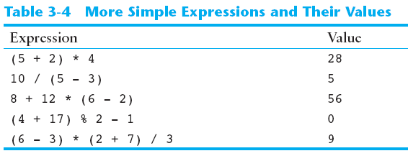
Grouping with Parentheses
parentheses ( ) can be used to override the order of operations:
2 + 2 * 2 – 2 = 4
(2 + 2) * 2 – 2 = 6
2 + 2 * (2 – 2) = 2
(2 + 2) * (2 – 2) = 0

Slide 18
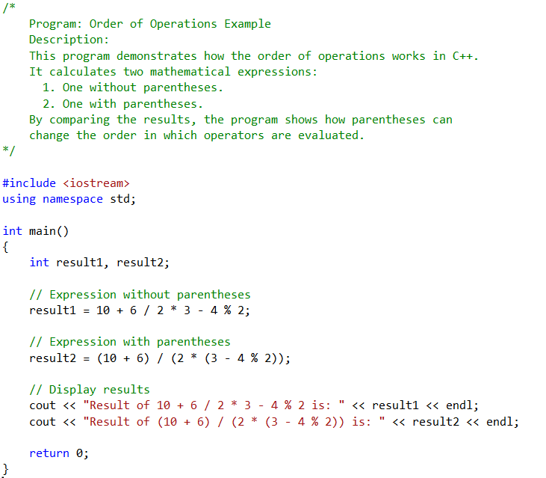

Example

Slide 19
Algebraic Expressions
Multiplication requires an operator:
Area=lw is written as Area = l * w;
There is no exponentiation operator:
Area=s² is written as Area = pow(s, 2); (note: pow requires the cmath header file)
Parentheses may be needed to maintain the order of operations:
is written as
m = (y2-y1) /(x2-x1);

Slide 20
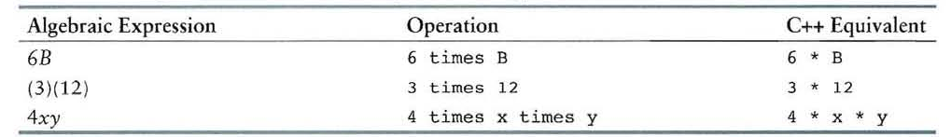
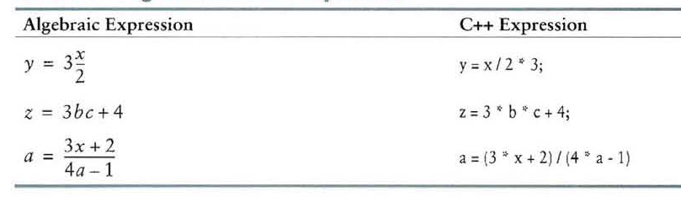
Cont.

Slide 21
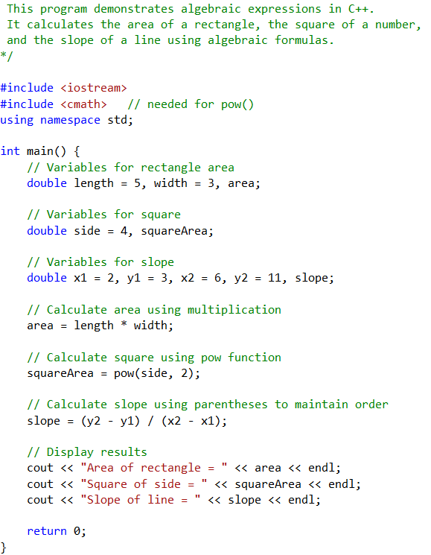
Example

Slide 22
When You Mix Apples with Oranges: Type Conversion
Operations are performed between operands of the same type.
If not of the same type, C++ will convert one to be the type of the other
This can impact the results of calculations.

Slide 23
Hierarchy of Types
Highest:
Lowest:
Ranked by the largest number they can hold
long double
double
float
unsigned long
long
unsigned int
int

Slide 24
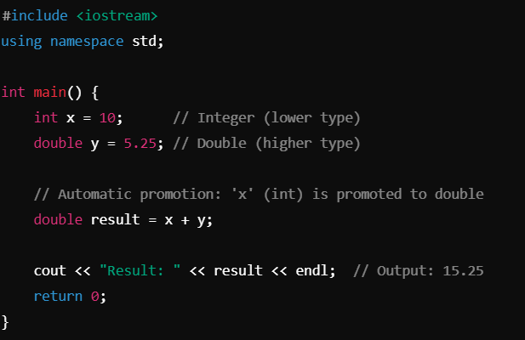
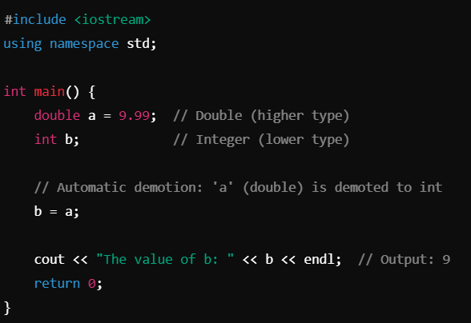
Type Coercion
automatic conversion of an operand to another data type
Promotion: convert to a higher type
Demotion: convert to a lower type

Slide 25
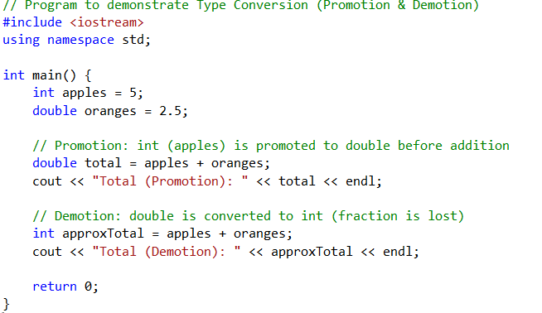
Example

Slide 26
Coercion Rules الاكراه
char, short, unsigned short automatically promoted to int
When operating on values of different data types, the lower one is promoted to the type of the higher one.
3) When using the = operator, the type of expression on right will be converted to type of variable on left

Slide 27
Overflow and Underflow
Occurs when assigning a value that is too large (overflow) or too small (underflow) to be held in a variable
Variable contains a value that is ‘wrapped around’ a set of possible values

Slide 28
Type Casting in C++
Type casting performs manual data type conversion.
Type Casting Syntax:
C++ also supports two older methods of creating type cast expressions
The C-style Syntax :
The C++ casting Syntax:
Static_cast <Data Type>(Variable)
(Data Type) Variable
Data Type (Variable)

Slide 29

Type Casting
Useful for floating-point division using int:
double m; m = static_cast<double>(y2-y1)/(x2-x1);
Useful to see int value of a char variable:
char ch = 'C';
cout << ch << " is "
<< static_cast<int>(ch);
cout << ch << " is " << (int) ch;
cout << ch << " is " << int(ch);

Slide 30
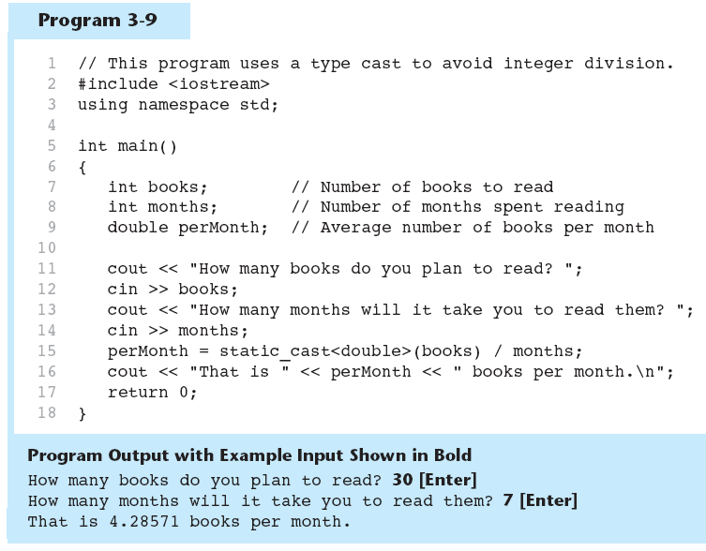

Type Casting in Program 3-9

Slide 31
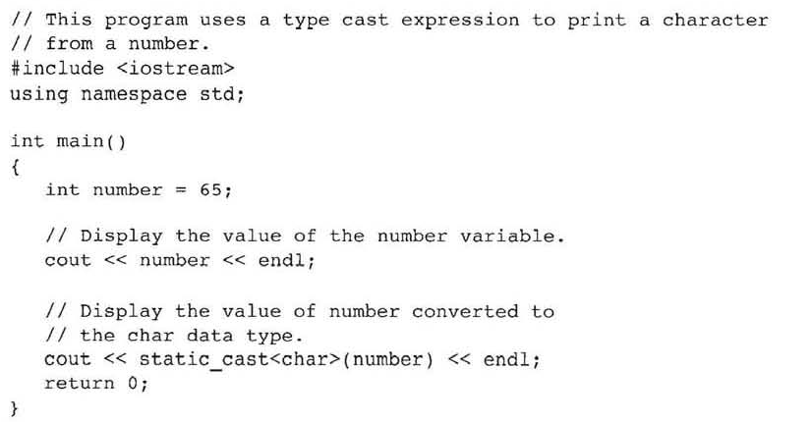

Example

Slide 32
Typecast Warnings
the following statement would still have resulted in integer division:
perMonth = float(books / months);
Because the division is performed first and the result is cast to a float.

Slide 33
Named Constants
Also called constant variables
Variables whose content cannot be changed during program execution
Used for representing constant values with descriptive names
const double TAX_RATE = 0.0675;
const int NUM_STATES = 50;
const double PI= 3.14
Often named in uppercase letters
Notes:
See pr3-11.cpp

Slide 34
Benefits of Named Constants
Makes program code more readable by documenting the purpose of the constant in the name:
const double TAX_RATE = 0.0675;
salesTax = purchasePrice * TAX_RATE;
Simplifies program maintenance:

Slide 35
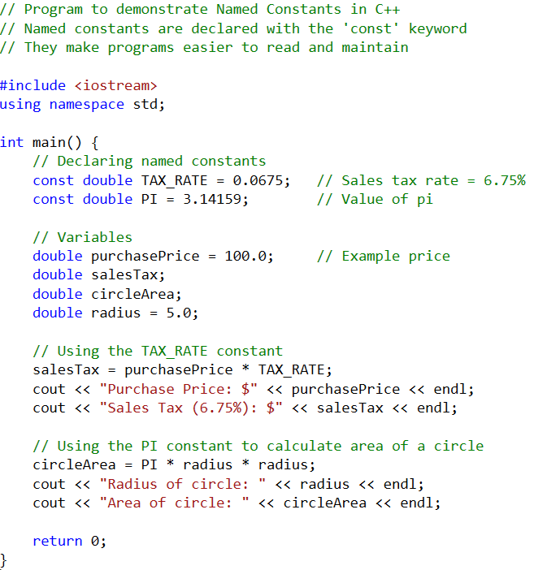
Example

Slide 36
const vs. #define
#define
C-style of naming constants
#define NUM_STATES 50
Interpreted by pre-processor rather than compiler
Does not occupy a memory location like a constant variable defined with const
Instead, causes a text substitution to occur. In above example, every occurrence in program of NUM_STATES will be replaced by 50

Slide 37
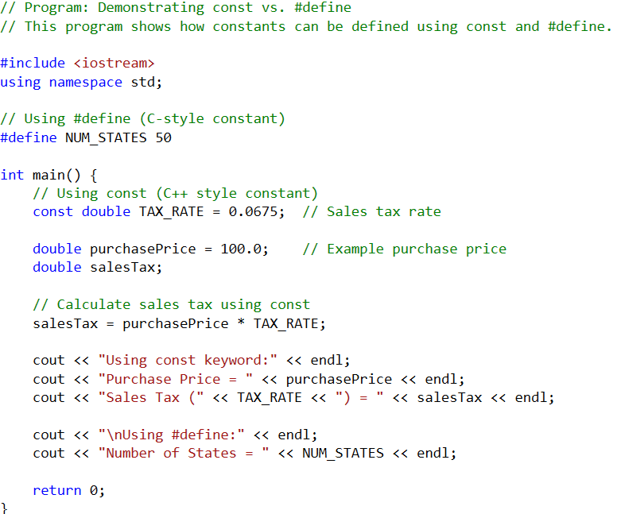
Example

Slide 38
Multiple and Combined Assignment
The assignment operator (=) can be used multiple times in an expression
x = y = z = 5;
Associates right to left
x = (y = (z = 5));
Done Done Done
3rd 2nd 1st

Slide 39
Combined Assignment
Applies an arithmetic operation to a variable and assigns the result as the new value of that variable
Operators: += -= *= /= %=
Also called compound operators or arithmetic assignment operators
Example:
sum += amt; is short for sum = sum + amt;

Slide 40
More Examples
x += 5; means x = x + 5;
x -= 5; means x = x – 5;
x *= 5; means x = x * 5;
x /= 5; means x = x / 5;
x %= 5; means x = x % 5;
The right-hand side is evaluated before the combined assignment operation is done.
x *= a + b; means x = x * (a + b);

Slide 41
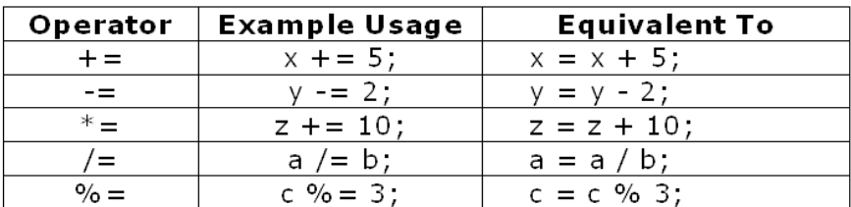
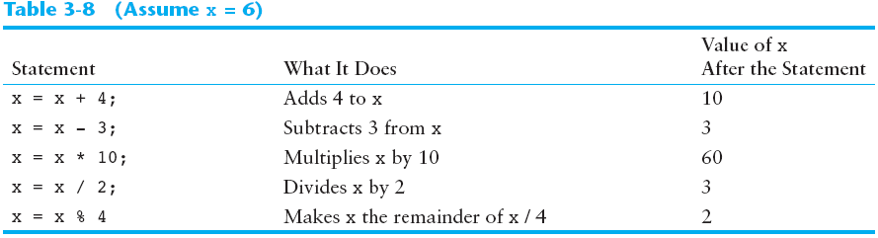
Example

Slide 42
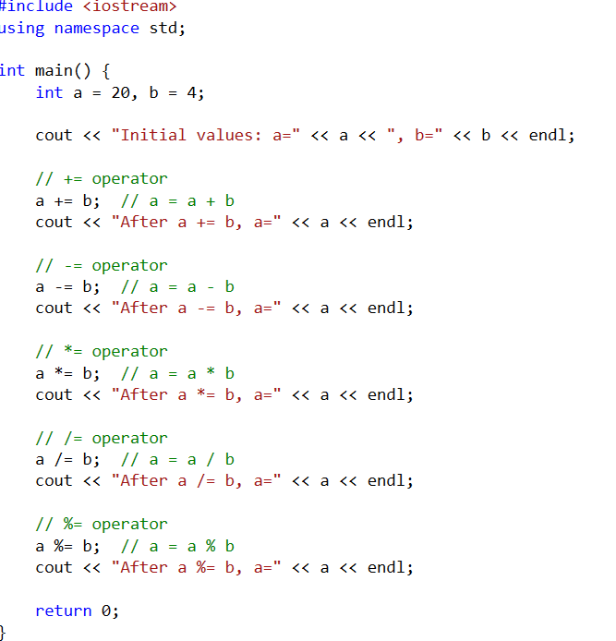
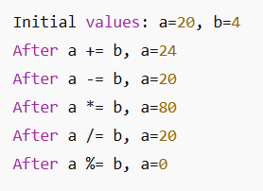
Example

Slide 43
Output Formatting

Slide 44
Formatting Output
Formatting is the way of appearing data on the screen.
The cout object used to accomplishes this task.
C++ has special instructions that allow the user to control output attributes such as spacing, decimal point precision, data formatting, and other features.

Slide 45
Formatting Output
Can control how output displays for numeric and string data
size
position
number of digits
Requires iomanip header file.
Notes:
For an example without iomanip, see pr3-14.cpp

Slide 46
Formatting Output
Manipulators are operators used in C++ for formatting output.
Description | Stream Manipulator
Establishes a print field of n spaces. | setw(n)
Displays floating-point numbers in fixed point notation. | Fixed
Causes a decimal point and trailing zeroes to be displayed, even if there is no fractional part. | showpoint
Sets the precision of floating-point numbers. | setprecision (n)
Causes subsequent output to be left justified. | left
Causes subsequent output to be right justified. | right

Slide 47

“setw” Manipulator
setw(x): Print in a field at least x spaces wide. It will use more spaces if specified field width is not big enough.
Syntax of setw :
will leaf blank spaces before value of variable.
Example:
cout << setw(10) << price << setw(7) << rate<<endl;
output:
Setw(field width)

Slide 48
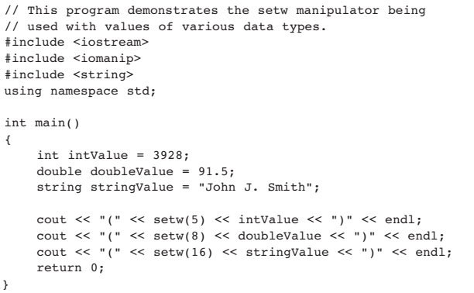

Stream Manipulators
Notes:
See pr3-15.cpp and pr3-16.cpp

Slide 49
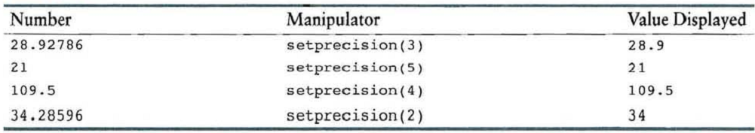
The “setprecision” Manipulator
The precision is the total number of digits that appear before and after the decimal point.
The number of significant digits with which floating-point values are displayed by using the setprecision manipulator.
Syntax of setprecision :
Example:
setprecision(significant digits)

Slide 50
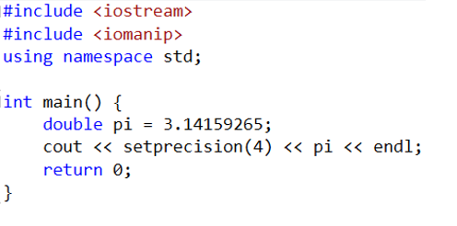

Example

Slide 51
The “fixed” Manipulator
In C++, fixed is a stream manipulator (from <iomanip>) that controls how floating-point numbers are displayed when printed using cout.
Normally, when you print a floating-point number (like 3.14159), cout may switch automatically between:fixed-point notation (normal decimal form, e.g. 3.14159)scientific notation (e.g. 3.14159e+00)
When the fixed and setprecision manipulators are used together, the value specified by the setprecision manipulator will be the number of digits to appear after the decimal point, not the number of signficant digits.

Slide 52
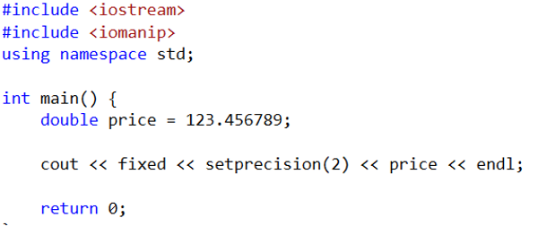

Example

Slide 53
The “showpoint” Manipulator
By default, f1oating-point numbers are not displayed with trailing zeroes, and f1oating-point numbers that do not have a fractional part are not displayed with a decimal point.
If we want the numbers padded with trailing zeroes, we must use the showpoint manipulator .

Slide 54
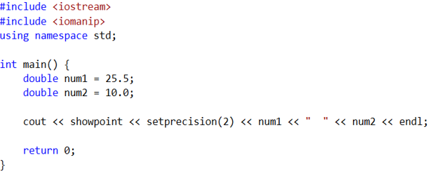

Example

Slide 55
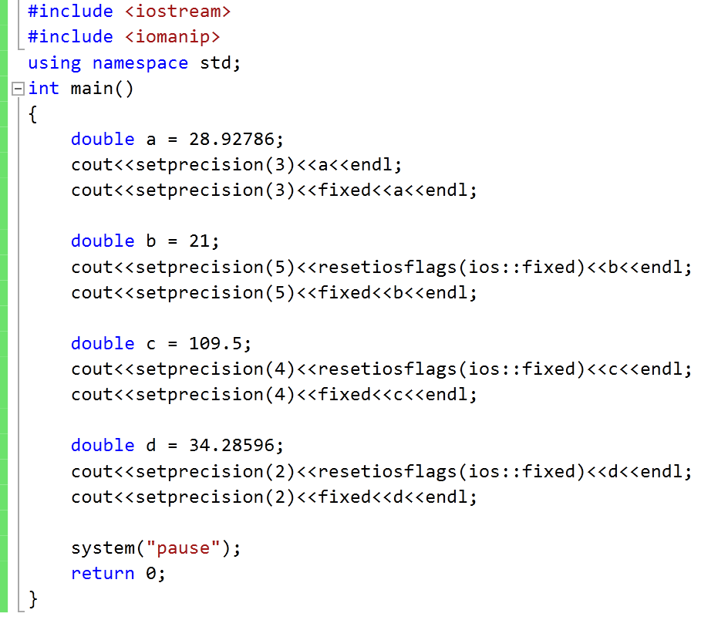
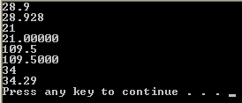
Exercises

Slide 56
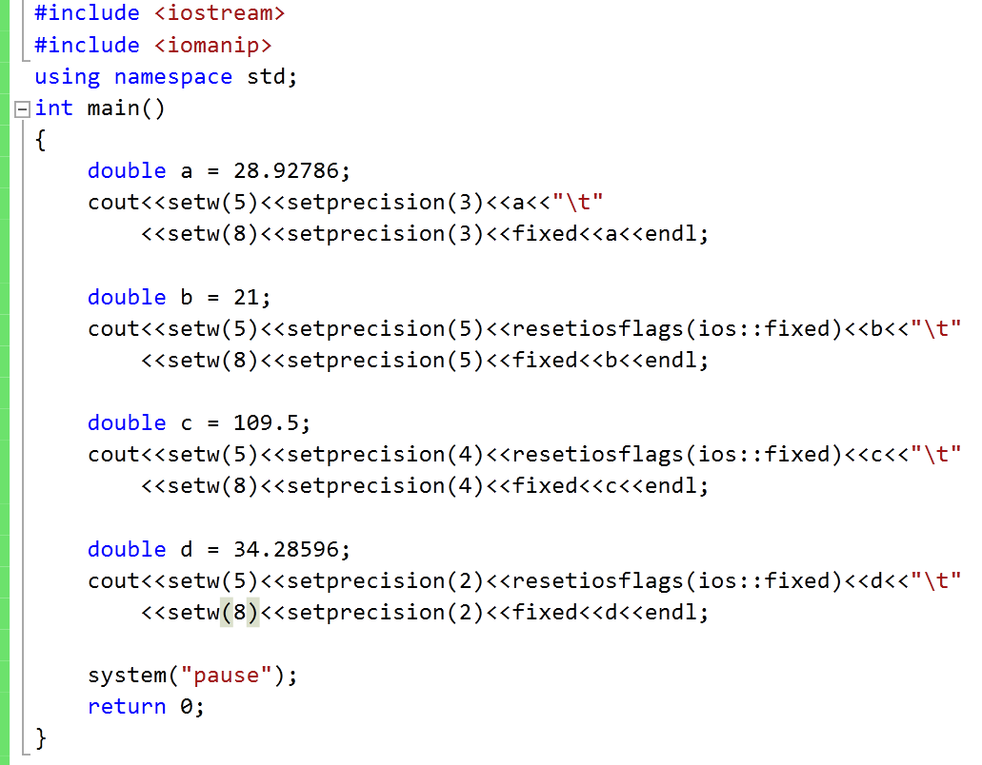

Exercises

Slide 57
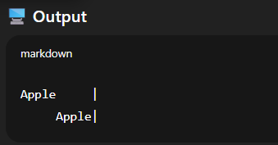
The left and right Manipulators
In C++, left and right are output manipulators from the <iomanip> library.
They control how text or numbers are aligned when printed in a given field width (set by setw()).
left → aligns the output to the left of the field (spaces added to the right).
#include <iostream>
#include <iomanip> // for setw, left, right
using namespace std;
int main() {
cout << setw(10) << left << "Apple" << "|" << endl;
cout << setw(10) << right << "Apple" << "|" << endl;
return 0;
}

Slide 58
Stream Manipulators
Some affect values until changed again
fixed: Use decimal notation (not E-notation) for floating-point values.
setprecision(x):
When used with fixed, print floating-point value using x digits after the decimal.
Without fixed, print floating-point value using x significant digits.
showpoint: Always print decimal for floating-point values.
left, right: left-, right justification of value
Notes:
See pr3-17.cpp, pr3-18.cpp, pr3-19.cpp, and pr3-20.cpp

Slide 59
Thank you

